Slide 1
Analyzing Home-Field Advantage in the NFL
Cepehr Alizadeh
Seth Harrison
Marin Lolic
Anoop Nath

Slide 2
Our Research Question
Does the home team really do better on average? If so, why?

Slide 3
Executive Summary
Historically, home teams have undoubtedly enjoyed an advantage over away teams in the NFL
However, the advantage has fluctuated over time in our study period (2000 - 2020)
In the most recent two seasons (2019 and 2020), the advantage has virtually disappeared
Home field advantage varies considerably by team, from almost zero points to more than ten
Of the variables we used to predict home-field advantage, none were statistically significant at the 95% confidence level
Distance between home and away team stadiums came closest to being significant
More research is needed to determine the cause of home-field advantage and why it has declined over time

Slide 4
Our Data
Sources
Cleaning and Organizing
The game data from 2000 to 2020 came from www.pro-football-reference.com, a popular repository of NFL statistics
We created a web scraper to gather the data from Pro Football Reference
Geographical data came from https://www.findlatitudeandlongitude.com and https://elevation.maplogs.com
Weather data came from www.nflweather.com
We merged the various data sources using common keys
We split the data into separate columns as necessary to facilitate the analysis
We ensured that all data was consistent, especially for teams that changed their names or home cities in the previous 20 years

Slide 5
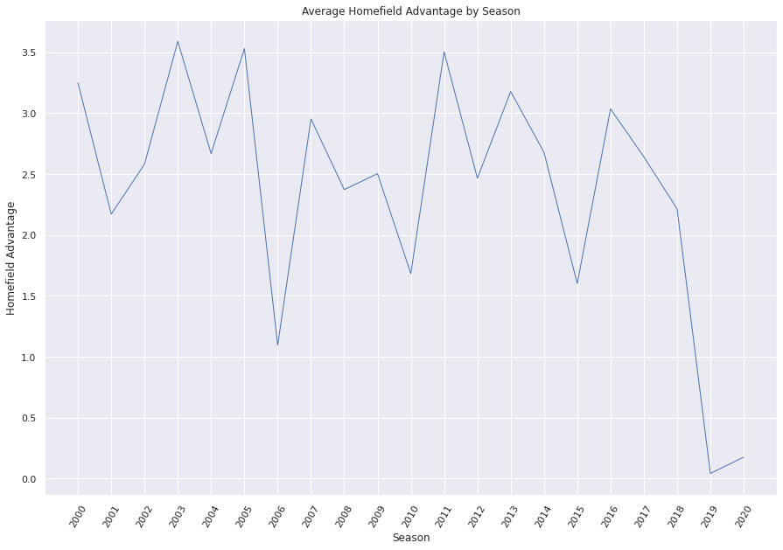
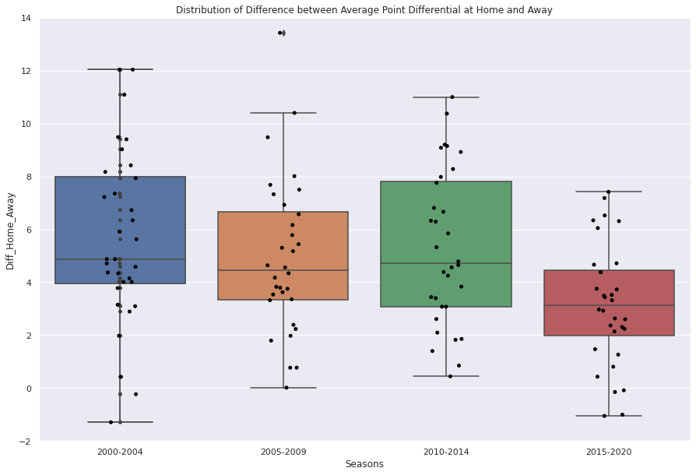
The Long-Term Picture
Home-Field Advantage Is Real…
…But Declining

Slide 6
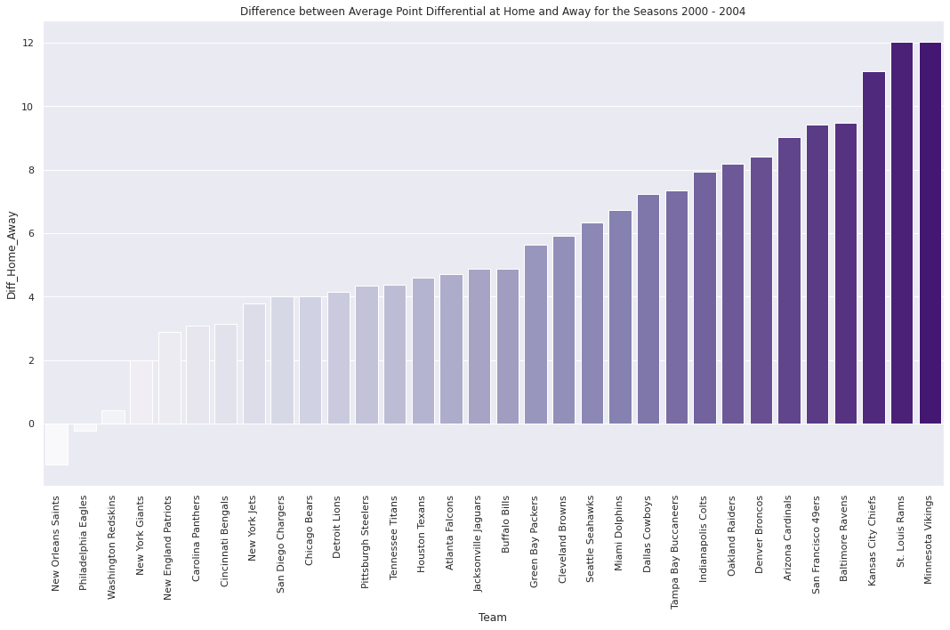
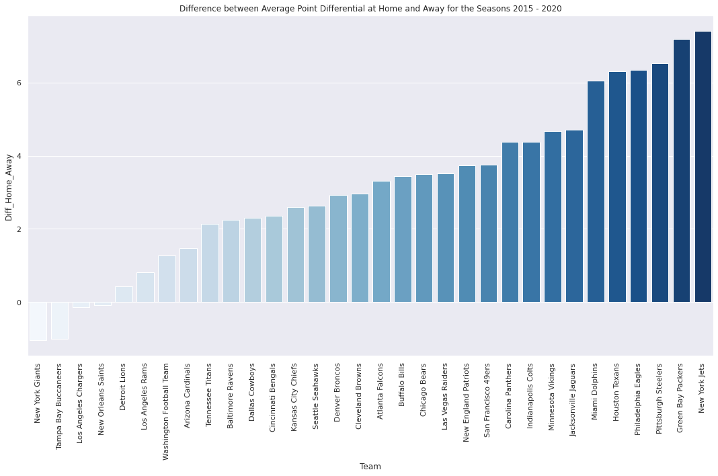
Advantage By Team Over Time
Not All Home Fields Are Equal, Or Consistent

Slide 7
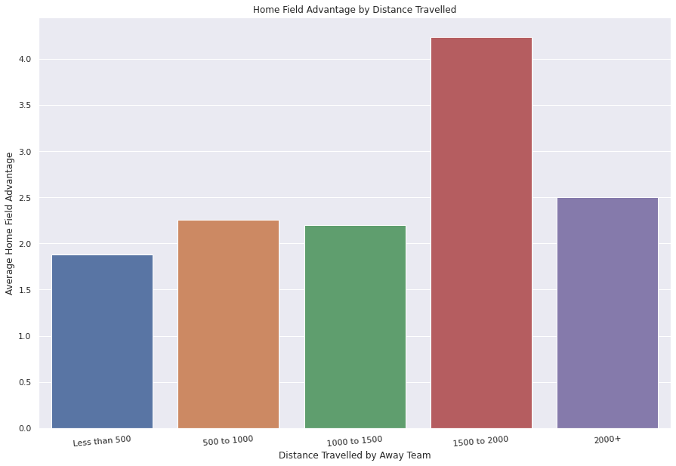
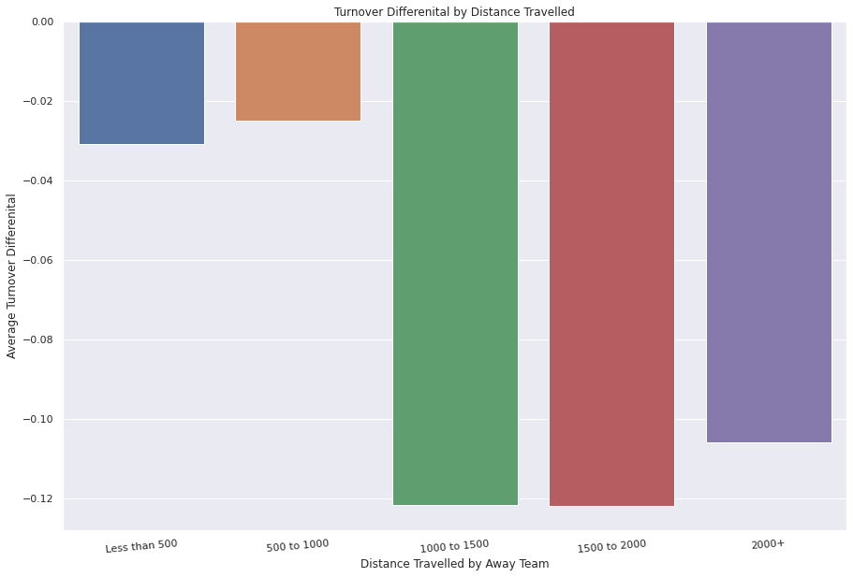
Distance Traveled Is A Possible Explanation
Away Teams May Be More Tired And Less Focused

Slide 8

Regression Analysis Offers Few Answers
In every regression we ran, the intercept (base home-field advantage) was highly significant
But other variables were not:
Distance of home vs. away stadium had a slope of .00051 and a p-value of 0.0867
Altitude and altitude differences did not seem to matter much (very high p-values)
Neither temperature nor wind-speed mattered
Fog seemed to favor the away team (p-value of 0.0167), but this could easily be a spurious correlation given the number of categorical weather variables (13 total)
“Upon further review, your models are useless”

Slide 9
Future Research
Why did home-field advantage suddenly drop so much in the 2019 season?
Does home crowd size have an impact on home-field advantage?
Do betting odds accurately predict home-field advantage?
How has home-field advantage been in the current season?

Slide 10
Any Questions?

